Slide 1
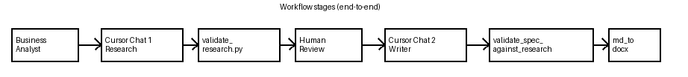

Slide 2
AI-Assisted Medicaid Integration Specification Generation Workflow
Cursor IDE
Cursor Agent
prompts/*.md
.cursor/rules
Integration Project (mes-cmds-member-eligibility)
source/MEMBERELIGIBILITY.csv
target/MemberEligibilityVO.md
research/*.yaml
spec/*.md + .docx
Research artifacts are validated before specification generation and DOCX export.
Shared Validation Library (medicare-validation-rules)
value-lists/*.csv
validate_research.py
md→docx
data-elements.md
validate_spec.py
MANIFEST.yaml
schema.json

Slide 3
Workflow Stages
Business Analyst
Cursor Chat 1 Research
validate_research.py
Human Review
Cursor Chat 2 Writer
validate_spec_against_research.py
md_to_docx.py
Research prompt + artifacts
Read source, VO, rules, VVLs
Write research/*.yaml
Schema + semantic checks
OK or errors
Review YAML mappings and gaps
Approved
Writer prompt + research YAML only
Write spec/*.md sections 1-5
Parity checks
Export .docx
Stakeholder deliverable

Slide 4
Cursor Control Plane
@ file references
integration-spec-research.md
integration-spec-research.mdc
medicaid-spec-conventions.mdc
(always)
integration-spec-write.md
integration-spec-writer.mdc

Slide 5
Workflow Overview
Start
Orchestrator script or Workflow Skill
Stage 2 human approve YAML
Stage 0 checks deps workspace files
Stage 3 emit Writer prompt new Chat 2
Stage 1 emit Research prompt open Chat 1
Cursor Writer Agent research only
Cursor Research Agent
spec Integration_Spec.md
Optional Task explore readonly
Stage 3b validate_spec_against_research.py
research Integration_Research.yaml
Stage 4 md_to_docx.py
Stage 1b validate_research.py
End

Slide 6
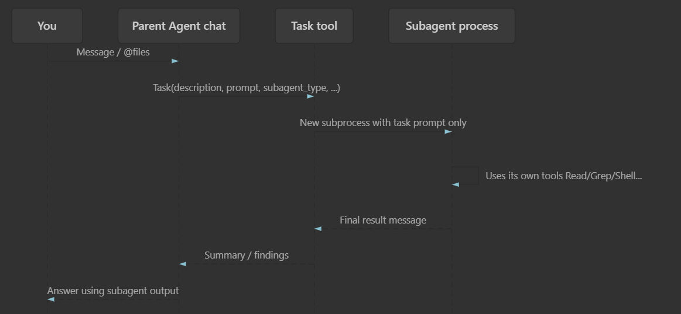

Slide 7
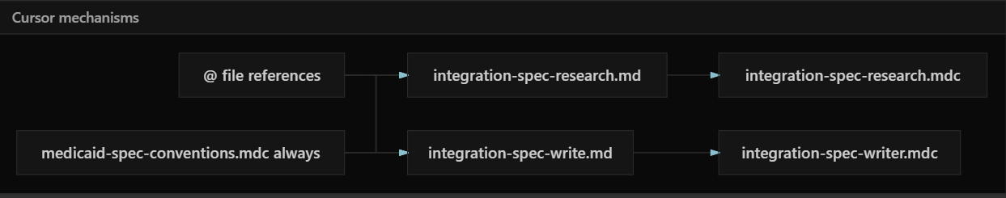

Slide 8
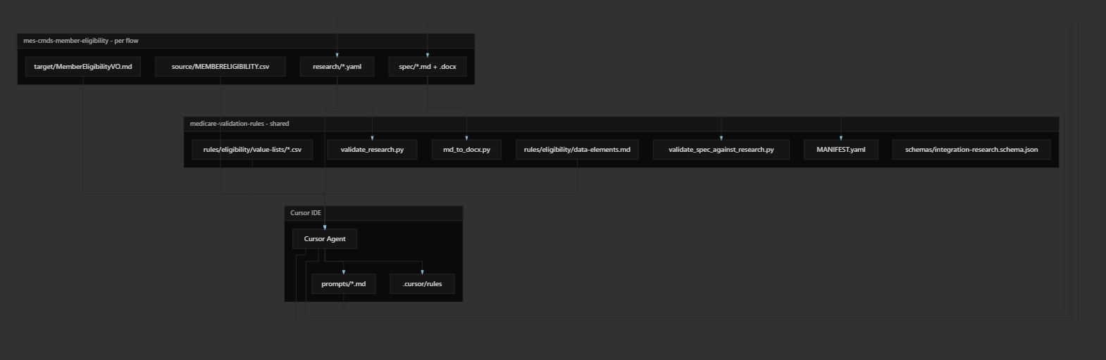

Slide 9
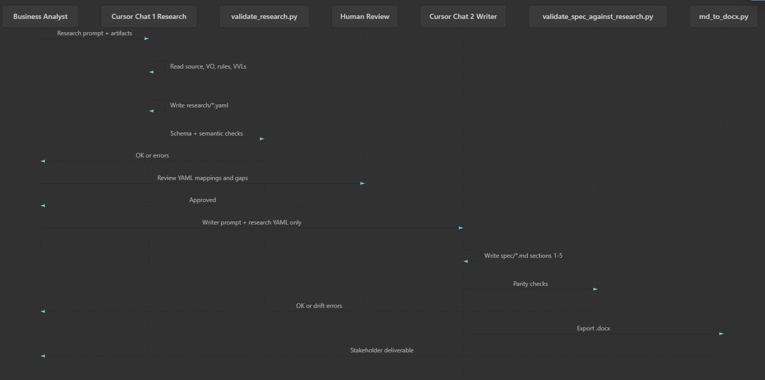

Slide 10
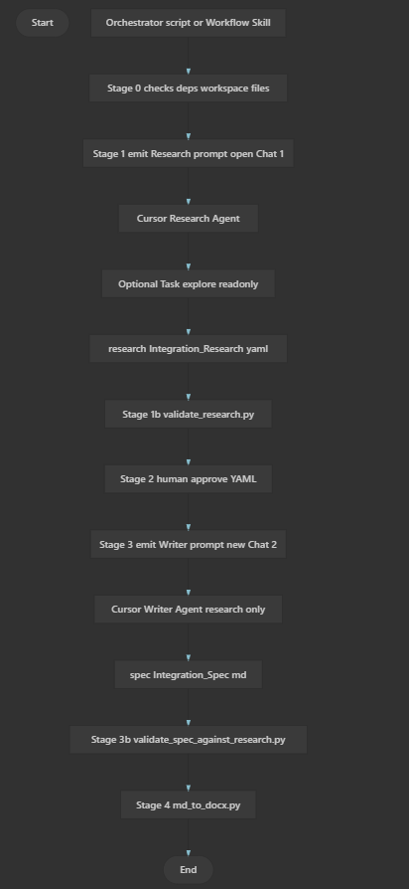

Slide 11
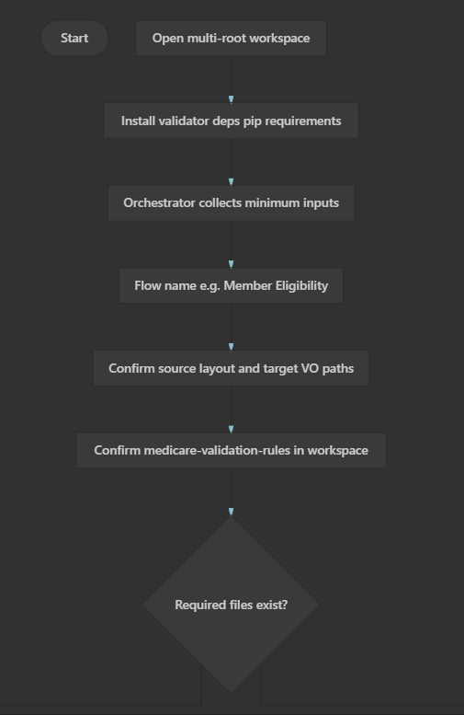

Slide 12
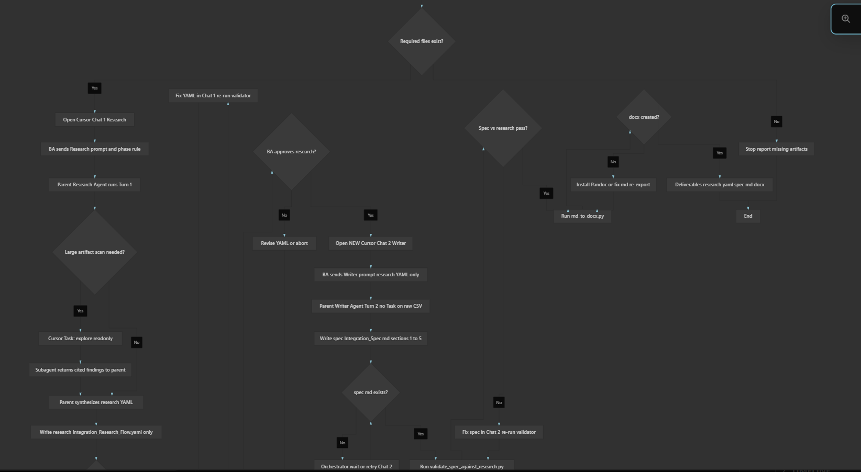

Slide 13
